Slide 1



Syndication Promotion Playbook
Get up to speed with the SHOP Local & Syndication Partners’ platform.

Slide 2




Bridging the Gap
Frictionless Solution

Slide 3

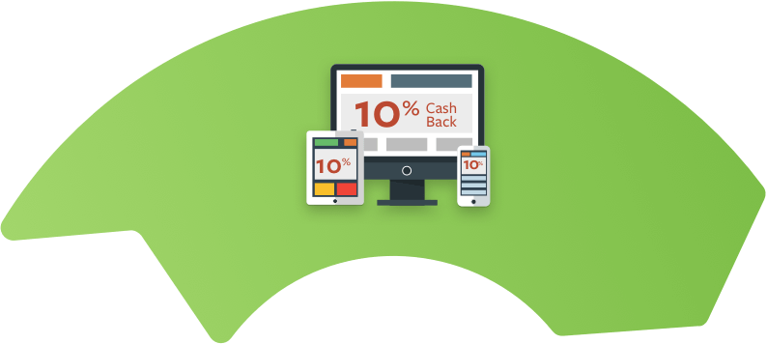





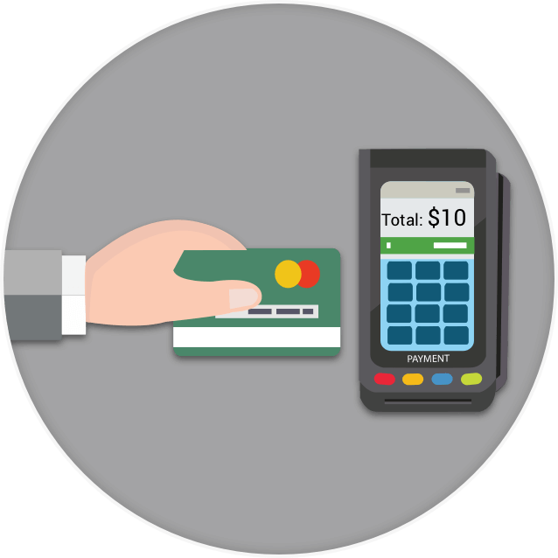
How it works -You only pay when a guest buys from you.
YOUR BUSINESS
You are Promoted on 100’s of Websites
Search engines, airlines, banks etc. market your
offer on their website and app.
Revenue is Shared
You share a small fraction of the revenue
with us and the websites that promoted you.
More Guests Pay You
Guests pay full price
for their purchases.

Slide 4









SHOP Local Syndication Partners
1,500
Participating Websites / Apps
175M+
Consumer Reach

Slide 5


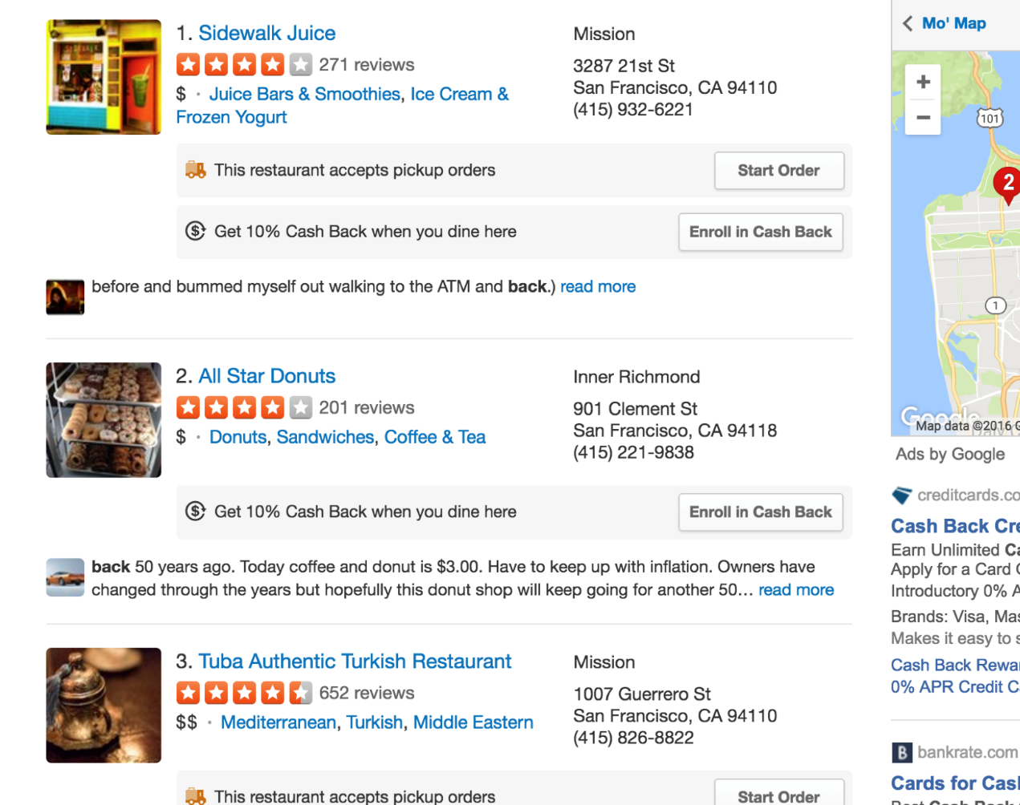
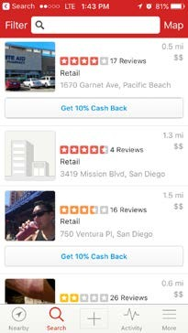

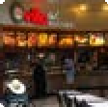
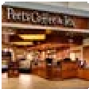
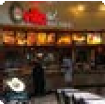
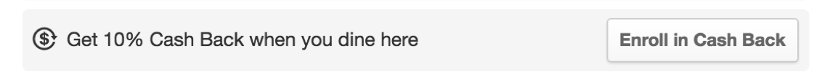

A few examples of where your store will be seen.
Your business will be promoted on 100’s of Websites and apps that consumers use.
YOUR BUSINESS
2. Competitor
YOUR BUSINESS
3. Competitor
4. Competitor

Slide 6
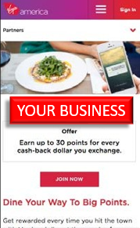
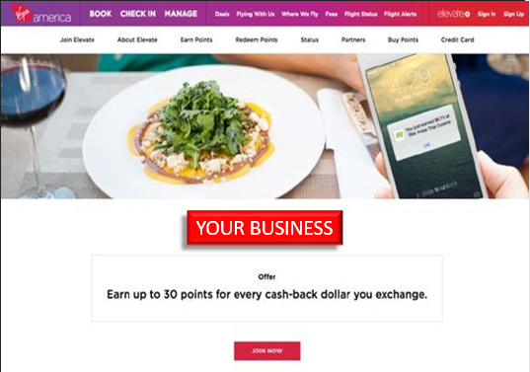
A few examples of where your store will be seen.
Your business will be promoted on 100’s of Websites and apps that consumers use.
YOUR BUSINESS

Slide 7

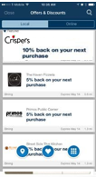

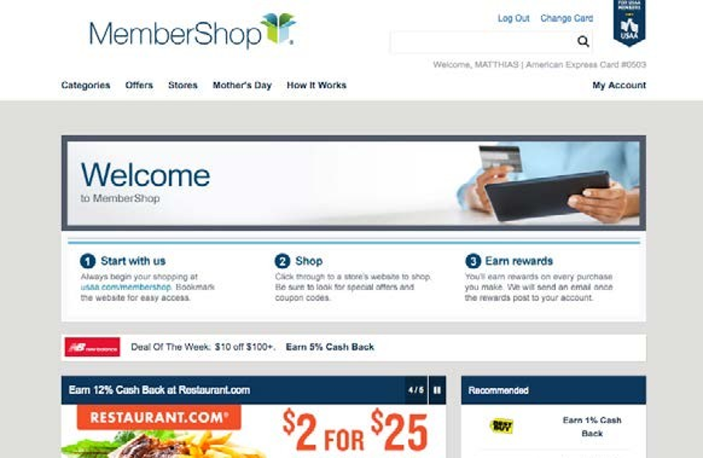
A few examples of where your store will be seen.
Your business will be promoted on 100’s of Websites and apps that consumers use.
YOUR BUSINESS
YOUR BUSINESS

Slide 8
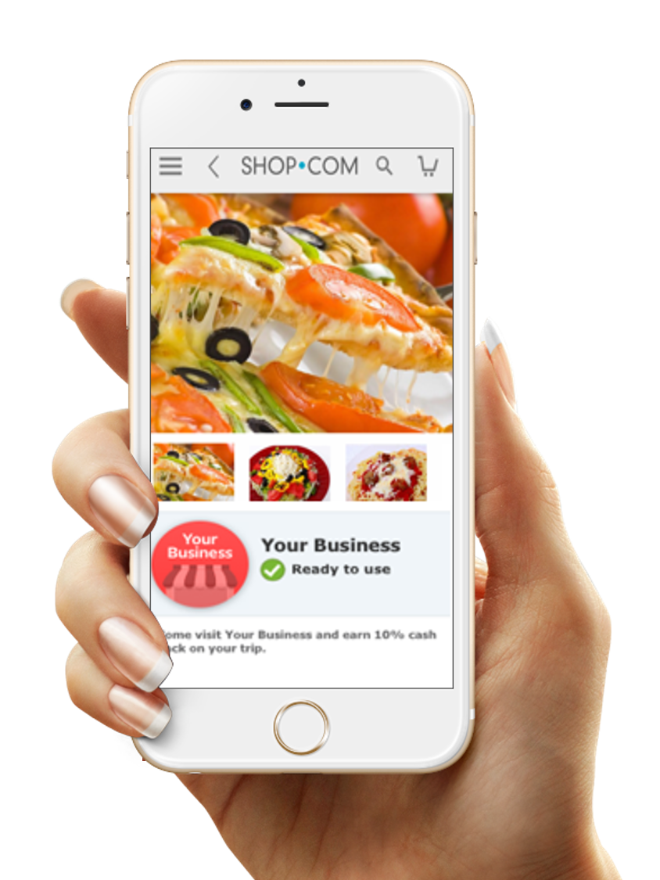
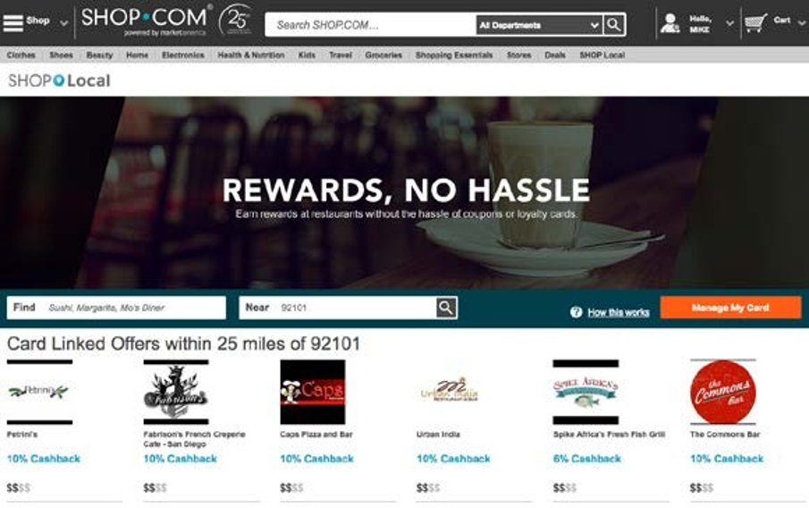
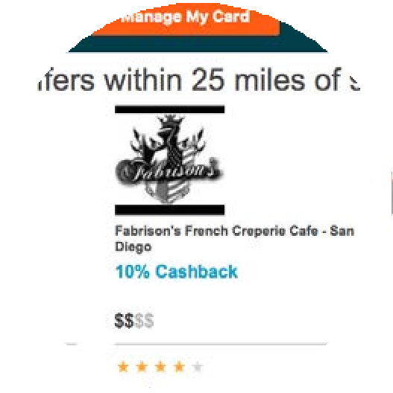
A few examples of where your store will be seen.
Your business will be promoted on 100’s of Websites and apps that consumers use.
YOUR BUSINESS

Slide 9


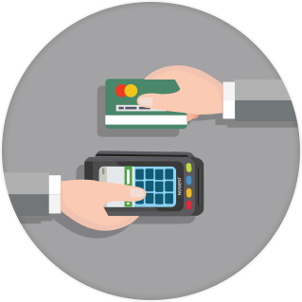




Nothing to install, nothing to train on.
Tons of customers are using our program to find and buy at stores just like yours every single day.
Nothing changes for you.
Guest always pays you full price.
No hardware or software needed.
No staff involvement or training.
No changes, just additional revenue.
No More Coupons & Less efforts
More Customers Pay You

Slide 10


















The Merchant is Charged a Fee
YOUR BUSINESS
Consumer pays Merchant $10
Merchant pays $2
$₁
$₁
$$
Syndication Partners
10% cash back to consumer
10% Cost Per Revenue (CPR™) is split by SHOP Local, Empyr & Syndication Partner

Slide 11
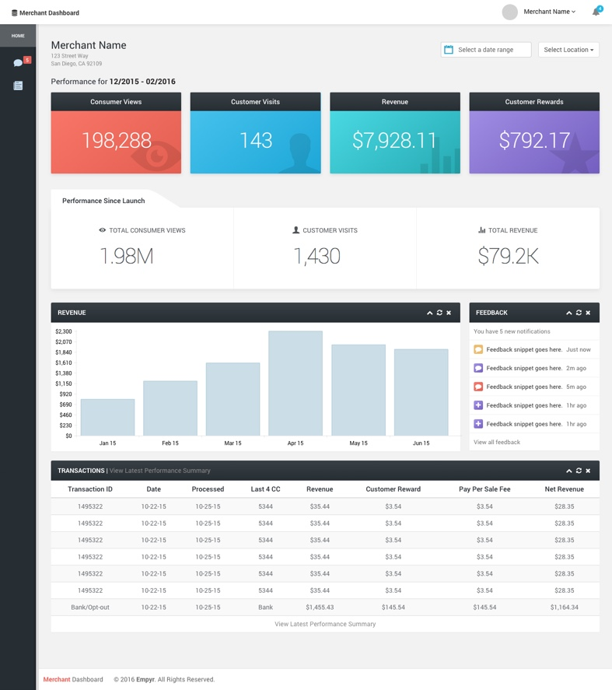
Transparent Reporting
Your monthly report shows you marketing performance in a clear and easy way.

Slide 12


Transparent Reporting
Your monthly report shows you marketing performance in a clear and easy way.
Customer Views
198,288
Customer views show how many people saw your business online.

Slide 13

Transparent Reporting
Your monthly report shows you marketing performance in a clear and easy way.
Customer Visits
143
Customer visits shows how many actual guests spent money at your restaurant.

Slide 14


Transparent Reporting
Your monthly report shows you marketing performance in a clear and easy way.
Revenue
$7,928.11
Revenue shows you
how much money you made.

Slide 15
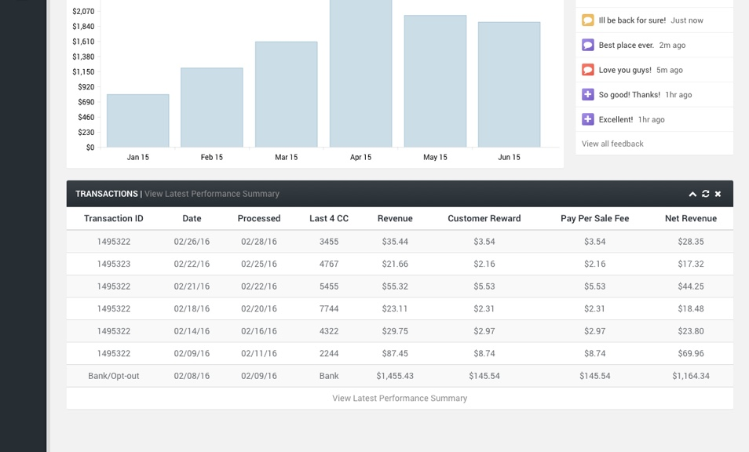
Transparent Reporting
Your monthly report shows you marketing performance in a clear and easy way.
Transaction History will match up with your Merchant Service Provider statement.

Slide 16

Online to Offline... Solved.

