Slide 1
The Snap Essentials Kit
A Collection of Essential Cleaners for Your Home

Slide 2
Snap™ Products – The Beginning
Snap originated in 1995
Safe, concentrated, plant-based ingredients
Environmentally-friendly before its time
Many Snap products are…
Biodegradable
Phosphate-free
Non-toxic
Made with recyclable or reusable bottles
Notes:
From the beginning snap was formulated with the environment in mind. When it originated in 1995, Snap was using plant-based ingredients and was biodegradable, phosphate free and nontoxic and using recyclable bottles.

Slide 3
WHAT MAKES THE SNAP ESSENTIALS KIT Environmentally friendly?
Plant-Based Ingredients
Safe, efficient and sustainable
Plant-based ingredients are pure, natural in origin and environmentally sustainable
We chose plant based ingredients because we want to make a impact on your home, not on the environment
Biodegradable
Capable of being decomposed by natural processes

Slide 4
WHAT MAKES THE SNAP ESSENTIALS KIT Environmentally friendly?
Non toxic
Not poisonous, harmful, or otherwise destructive upon exposure
Safe to use around kids and pets, and safe for the environment
Phosphate free
Phosphates leach into rivers & waterways
Serve as a food source for algae, resulting in excessive algae growth reducing oxygen levels in water which kills native fish and other aquatic creatures

Slide 5
WHAT MAKES THE SNAP ESSENTIALS KIT Environmentally friendly?
Made with Reusable Bottles
Packaging waste is a persistent problem in Australia. Australia produces over 4 million tones of packaging each year.
With our Snap Essentials Kit, 5 bottles are used to make 15 bottles of product
If reused just three times, this packaging uses over 66% less plastic!
Plus, these bottles can be reused many more times because they are crafted with high quality materials
If all plastic packing was like the Snap Essentials Kit we could eradicate over 2 million tons of plastic waste annually!
Notes:
https://www.cleanup.org.au/PDF/au/cua-cdl-submission-2008.pdf

Slide 6
State of the Industry- Eco-friendly cleaning products
According to Euromonitor International Report on Home Care Cleaning Products:
With rising exposure to global social and environmental issues, Australian consumers are increasingly paying attention to environmentally friendly home care products.
The increasing numbers of brands focusing on environmentally friendly and sustainable products is set to drive further growth in these products during the forecast period.
The housing market is expected to continue growing and supporting sales of home and garden specialist retailers over the forecast period.
When it comes to home care products, Australian consumers would generally prefer to judge a brand by its value for money when making their purchasing decisions.
Notes:
http://www.portal.euromonitor.com/portal/analysis/tab

Slide 7
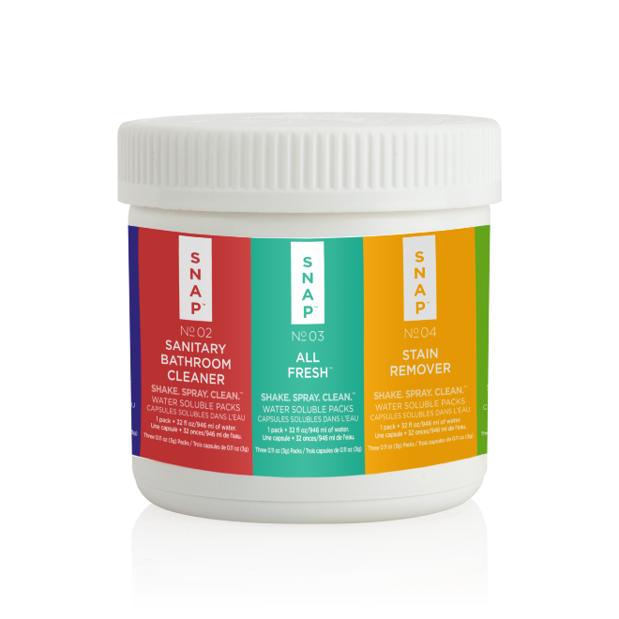
INTRODUCING THE SNAP ESSENTIALS KIT!
To keep every room in your home spotless, each kit includes 3 packs each of All-Purpose Cleaner, Sanitary Bathroom Cleaner, All Fresh™, Stain Remover and Dishwashing Liquid. Let our cost-effective, cutting edge formulas eradicate dirt, odors and stains ­— saving you time and money.
15 Bottles of Cleaning Solution

Slide 8
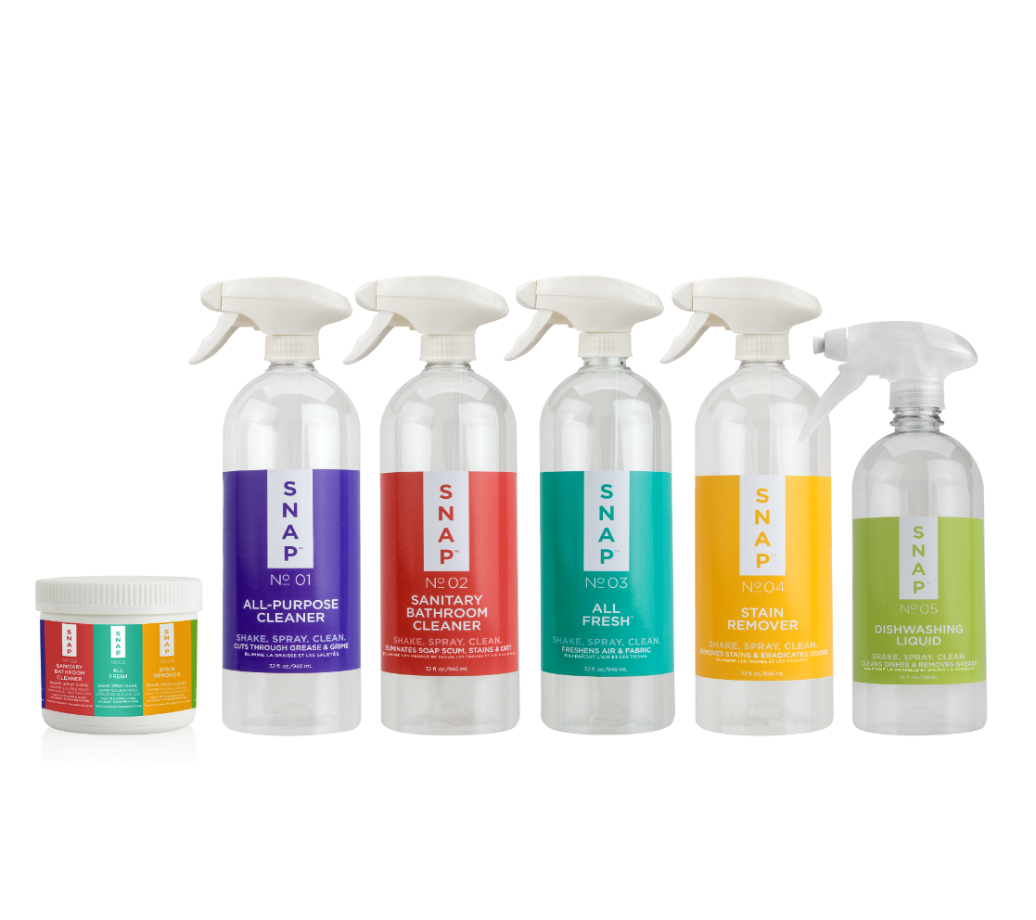
INTRODUCING THE SNAP ESSENTIALS KIT!
The kit also includes 5 labeled bottles for added convenience. These bottles are a reusable one-time buy, making them easier on the environment and your wallet!

Slide 9
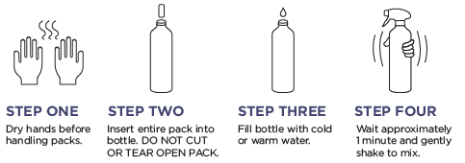
How do I use the snap essentials kit?
Our cutting edge formulas and innovative packaging are leading the way to the future of cleaning. Drop a pack into its matching labeled bottle, fill with water and wait one minute. Shake to mix, and it’s ready to go!

Slide 10
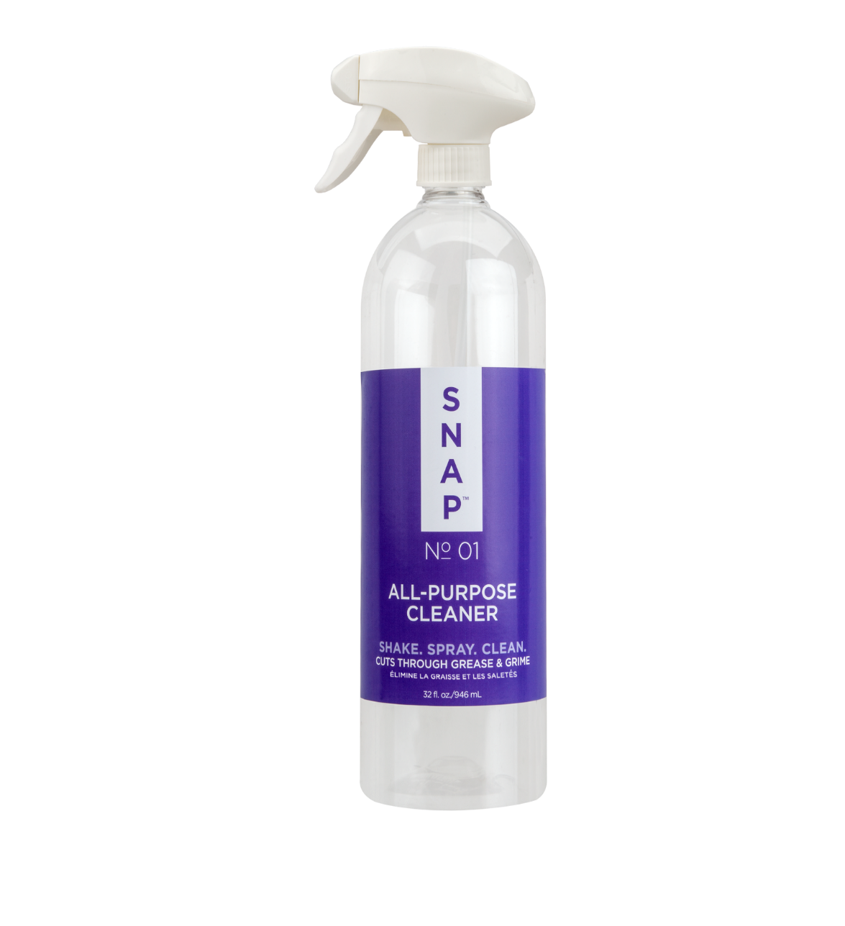
Snap™ All-Purpose Cleaner
Make your household surfaces gleam with Snap All-Purpose Cleaner! This strong and effective formula dissolves grease, films, smears and fingerprint marks from all household surfaces with ease.
Kit includes 3 packs of All-Purpose Cleaner
=
3 Bottles of Product

Slide 11
Snap™ All-Purpose Cleaner
Primary Benefits:
Cleaning agents derived from plant substances and compounds
Safe to use on a variety of surfaces.
Works on most household surfaces, including countertops, glass, mirrors and appliances
Dissolves grease, films, smears and fingerprints
No harsh chemicals or fumes
Contains no ammonia, bleach, or acidic components
Phosphate Free
Non-Toxic
Biodegradable

Slide 12
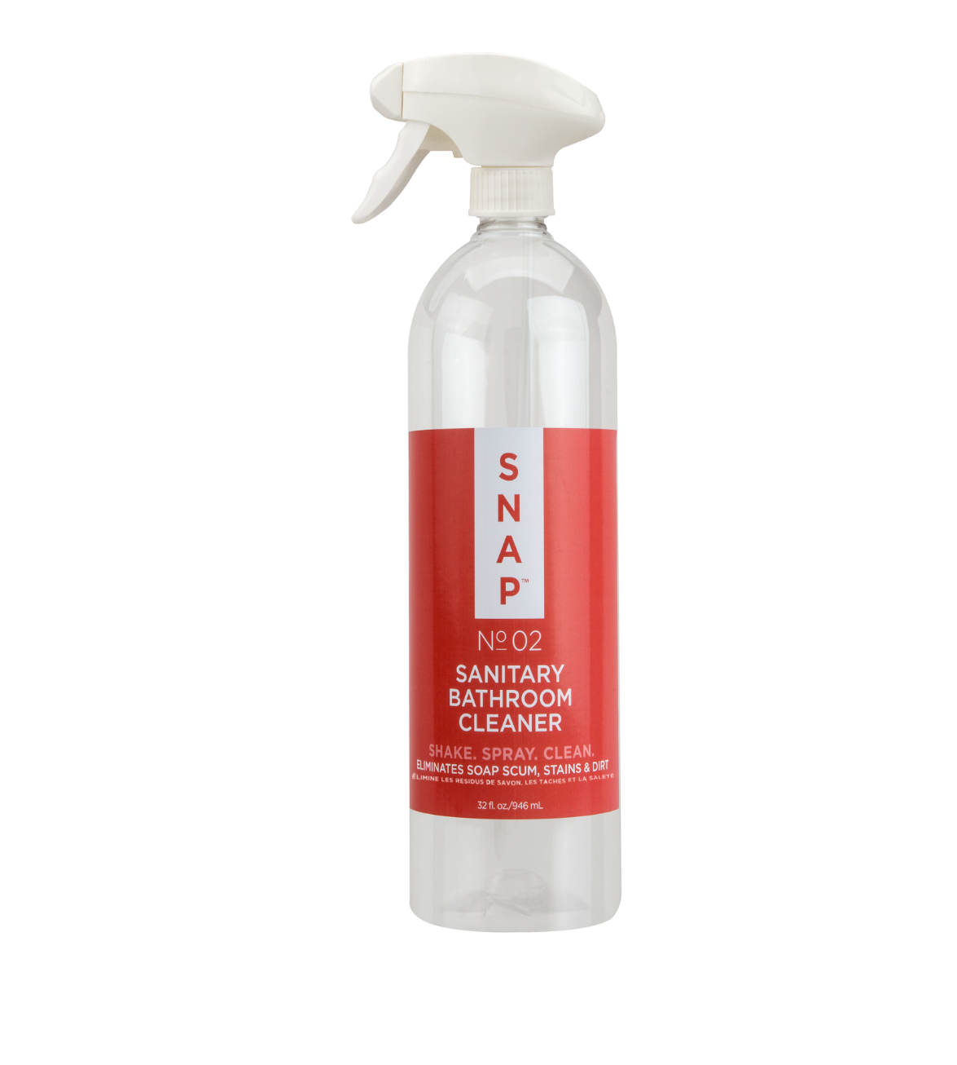
Snap™ SANITARY BATHROOM CLEANER
Sanitise your bathroom with Snap Sanitary Bathroom Cleaner! This mild, but highly effective bathroom cleaner easily eliminates soap scum, hard water stains, dirt and odors from bathroom surfaces.
Kit includes 3 packs of Sanitary Bathroom Cleaner
=
3 Bottles of Product

Slide 13
Snap™ SANITARY BATHROOM CLEANER
Primary Benefits:
Cleaning agents derived from plant substances and organic compounds
Easily eliminates soap scum, hard water stains, and dirt
Effectively removes dirt, grime, scum and grease from any water-safe surface without scratching
No ammonia
No harsh chemicals or fumes
Phosphate Free
Non-Toxic
Biodegradable

Slide 14
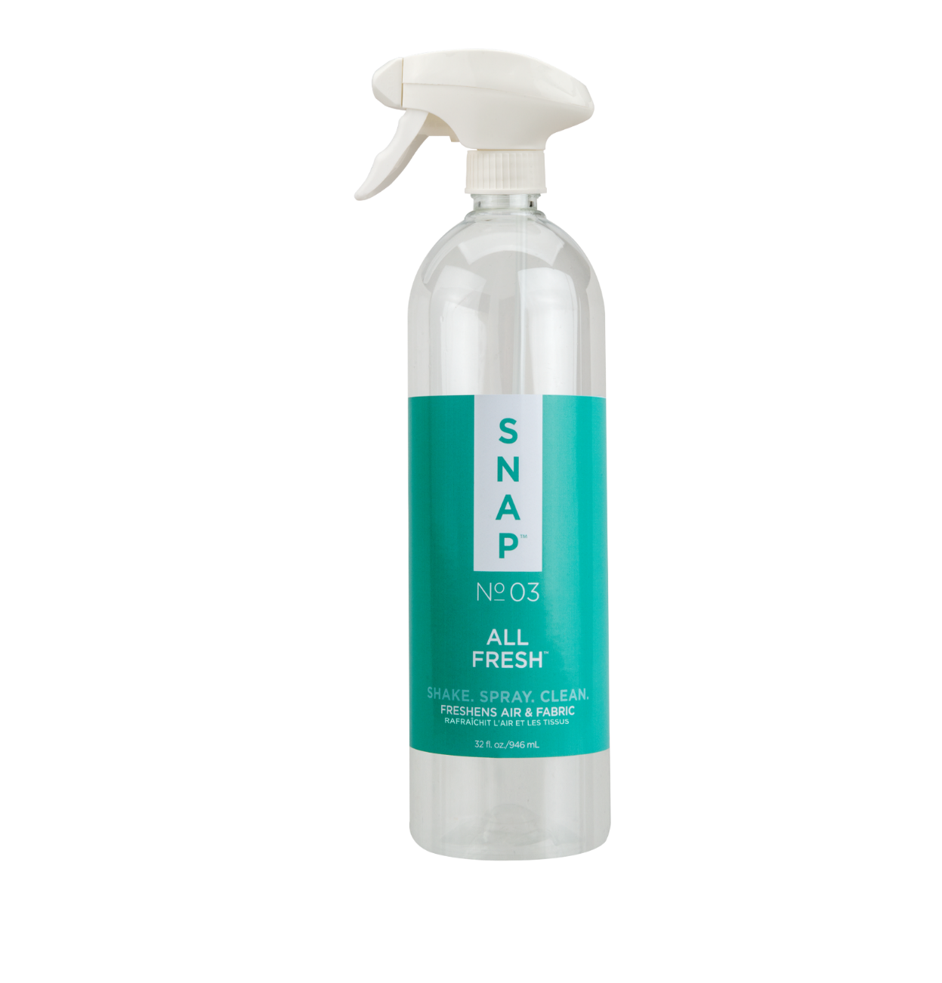
Snap™ ALL FRESH™
Don’t let unpleasant odors stink up your home, neutralise odours with Snap All Fresh! Simply spray to freshen up any room. Great for use on linen, laundry, carpets and more.
Kit includes 3 packs of All Fresh
=
3 Bottles of Product

Slide 15
Snap™ ALL FRESH™
Primary Benefits:
Cleaning agents derived from plant substances and compounds
Neutralises odours
Fresh scent
Excellent for use on airborne, fabric, pet, smoke, workout gear and cooking odours
Safe for all fabrics*
No harsh chemicals or fumes
Non-Toxic
Biodegradable
Phosphate-Free
* Test a small inconspicuous area of the fabric prior to using

Slide 16
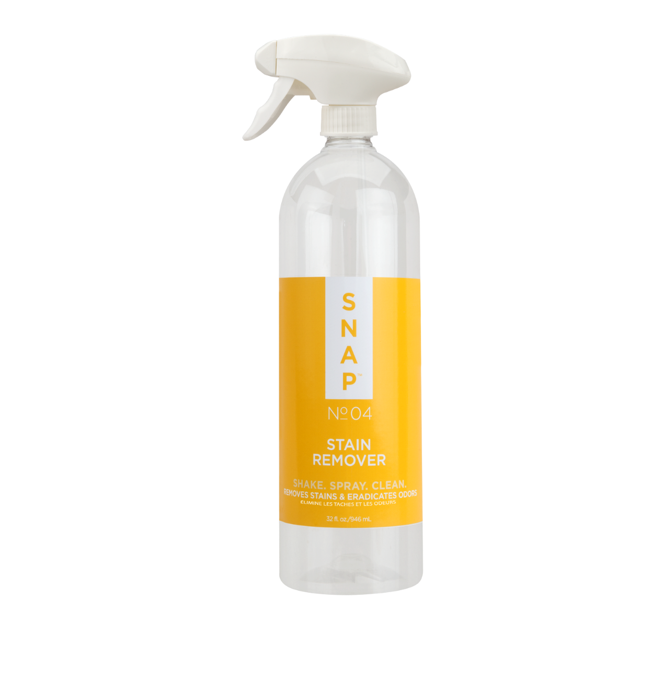
Snap™ STAIN REMOVER
Gently remove tough stains with Snap Stain Remover! Safely eradicate stains and odours with our superior, fast-acting formula. Excellent for use on clothing, carpets, upholstery and other washable fabrics.
Kit includes 3 packs of Stain Remover
=
3 Bottles of Product

Slide 17
Snap™ STAIN REMOVER
Primary Benefits:
Cleaning agents derived from plant substances and compounds
Gently removes tough stains while eliminating odours
Safe for all fabrics
Works on clothing, carpets, upholstery and other washable fabrics
No harsh chemicals or fumes
Non-Toxic
Biodegradable
Phosphate-Free

Slide 18
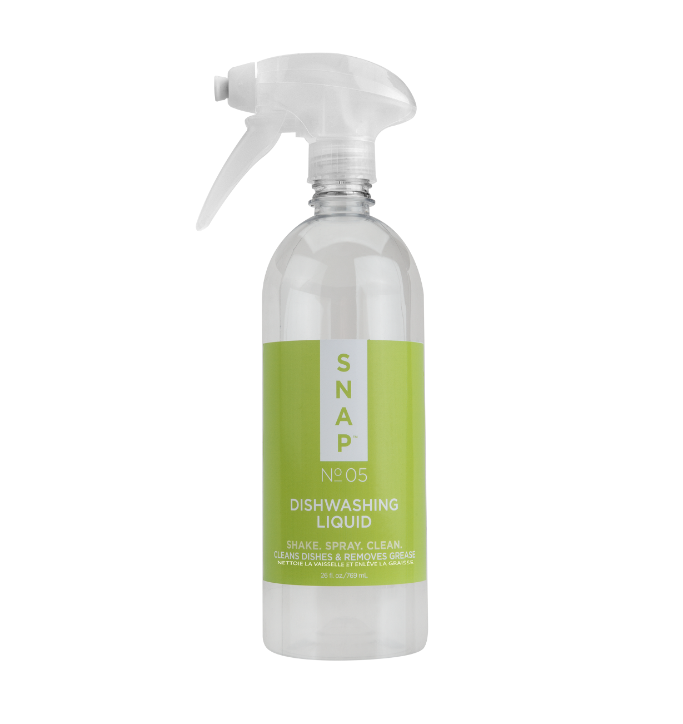
Snap™ DISHWASHING LIQUID
Keep your dishes sparkling with our concentrated, fast-acting detergent that’ll clean even the dirtiest dishes! This superior, pH-balanced formula penetrates heavy grease deposits while maintaining its suds.
Kit includes 3 packs of Dishwashing Liquid
=
3 Bottles of Product

Slide 19
Snap™ DISHWASHING LIQUID
Primary Benefits:
Cleaning agents derived from plant substances and organic compounds
Great alternative to conventional dish liquids
pH-balanced to be mild on your hands
Heavy-duty formula removes grease from your dirtiest dishes
Excellent for use on pots, pans, dishes and glassware
Phosphate-Free
Non-Toxic
Biodegradable

Slide 20
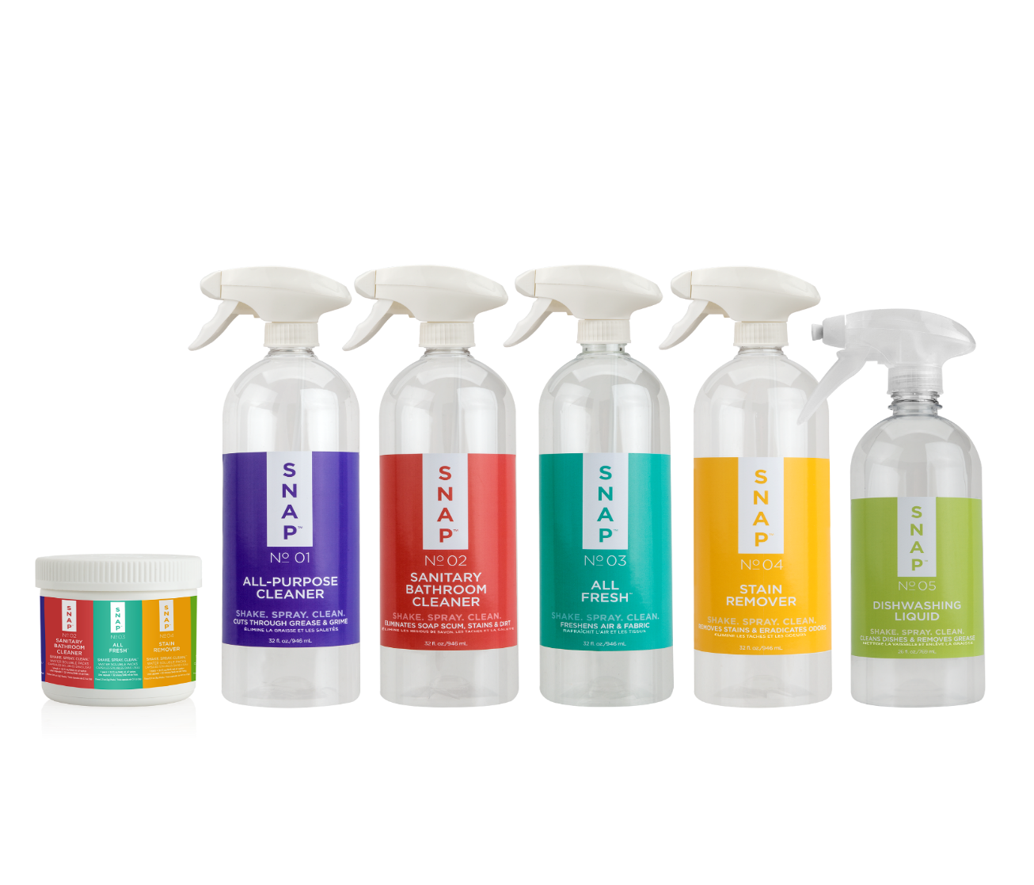
THE SNAP™ ESSENTIALS KIT
Clean your home in a snap with our collection of essential, and economical household cleaners. The Snap Essentials Kit contains everything you need to clean your home — all in one, easy-to-use pack!
Code: 76945
UC: $40.25 AUD
SR: $56.25 AUD
BV: 20

Slide 21
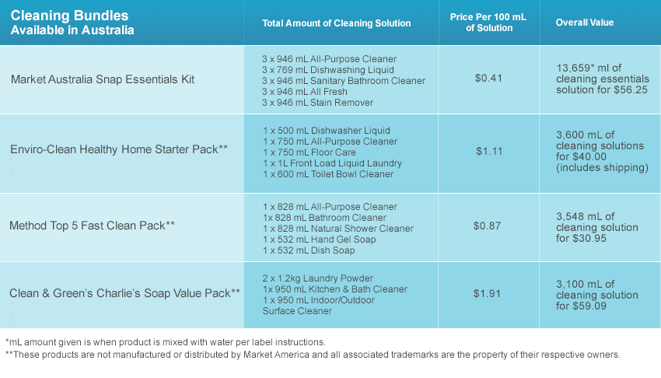
SnaP™ Essentials Kit Product comparison

Slide 22
Snap™ Essentials Kit Profit Chart
Code: 76945
UC: $40.25 AUD
SR: $56.25 AUD
BV: 20
 | Gross MONTHLY Profit Per # of Customers Reordering Each Month
AMOUNT | 10 | 25 | 50 | 100 | 250 | 500 | 1,000 | 1,500 | 3,000
AUD $ | $160 | $400 | $800 | $1,600 | $4,000 | $8,000 | $16,000 | $24,000 | $48,000
* The income levels mentioned in the following presentation are for illustration purposes only. They are not intended to represent the income of a typical Market Australia Independent Distributor, nor are they intended to represent that any given Independent Distributor will earn income in that amount. The success of any Market Australia Independent Distributor will depend upon the amount of hard work, talent and dedication he or she devotes to building his or her Market Australia business.

Slide 23
SOCIALISE WITH US :
LEARN MORE
Notes:
Be sure to visit us at AU.SHOP.COM today and follow us on social media!
Like us. facebook.com/marketaustralia
Find us. instagram.com/marketaustralia
Visit us. AU.SHOP.COM and GLOBAL.SHOP.COM
Watch us. youtube.com/marketaustraliaTV
Meet us. ma.meeton.com

Slide 24
Discover the ultimate home cleaning solution − the Snap Essentials Kit!
ESSENTIALS KIT

